Slide 1



Car Rental System
DEVANG PATEL INSTITUTE OF ADVANCE TECHNOLOGY AND RESEARCH
External Guide
Internal Guide
Prepared By
Mr. Pruthvi Darji
(Mentor)
Prof. Priyanka Padhiyar
(Assistant Professor)
Dhara Thakkar
(D21DCS153)

Slide 2


What is Car Rental System
The CAR RENTAL SYSTEM is being developed for customers so that they can book their vehicles from anywhere. A customer being registered on the website has the facility to book a vehicle

Slide 3
Why Car Rental System?
The proposed system is completely integrated with online systems. It automates manual procedures in an effective and efficient way.
It includes the type of vehicle they are trying to hire and the location.
This system aims to develop a website for the people who can book their vehicles along with requirements from any part of the country

Slide 4
Software Requirements
Operating System: Windows 10
Technology: React, NodeJS
Database: MongoDB
Web Server: Local
Browser: Chrome etc.
Node version: 18.16.0
Editor: VsCode
Hardware Requirements
Processor: Intel(R) Core(TM) i5-9500 CPU @ 3.00GHz 3.00 GHz
RAM: 8GB (Preferable)
Hard Disk: 256 GB

Slide 5
Assumptions And Dependencies
Each User Must Have Valid User ID and Password
Server must be running for the system to function.
Users must log in to the system to book any car.
Only the administrator can update , delete the records.

Slide 6
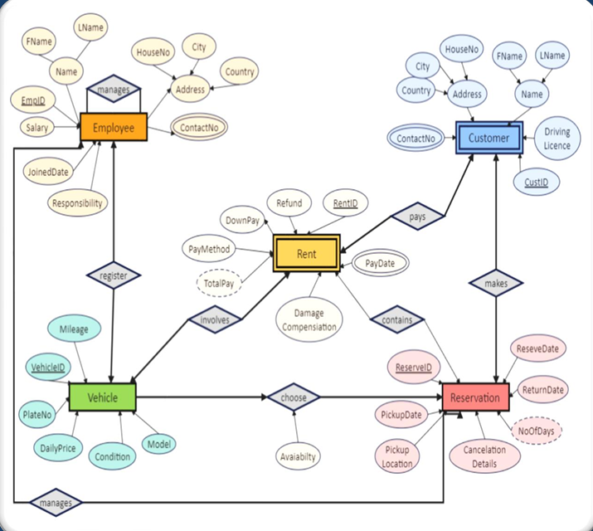
ER Diagram
ER Diagram

Slide 7
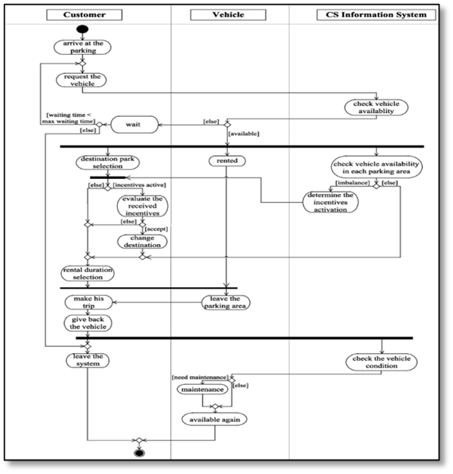
Activity Diagram
Activity Diagram

Slide 8
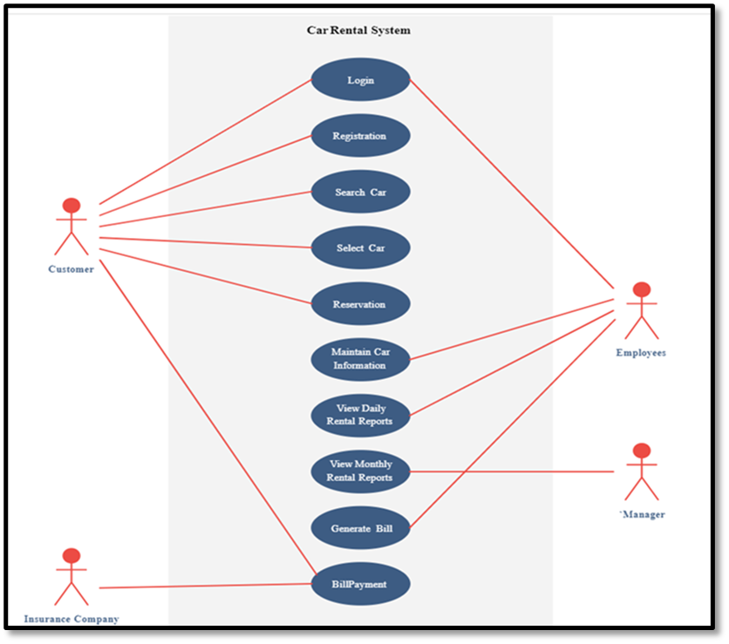
Use Case Diagram
Use Case Diagram

Slide 9
My Work In This Internship

Slide 10
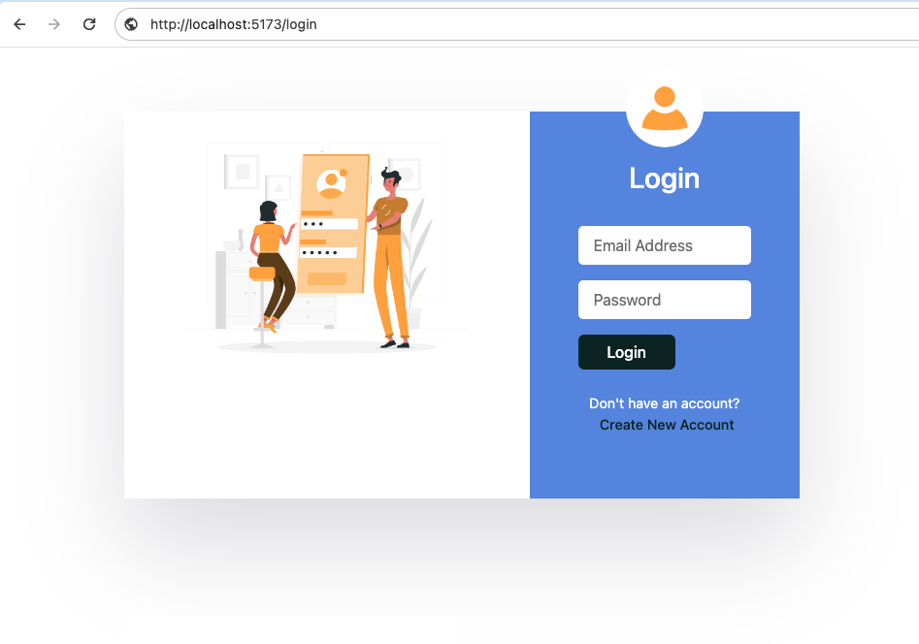
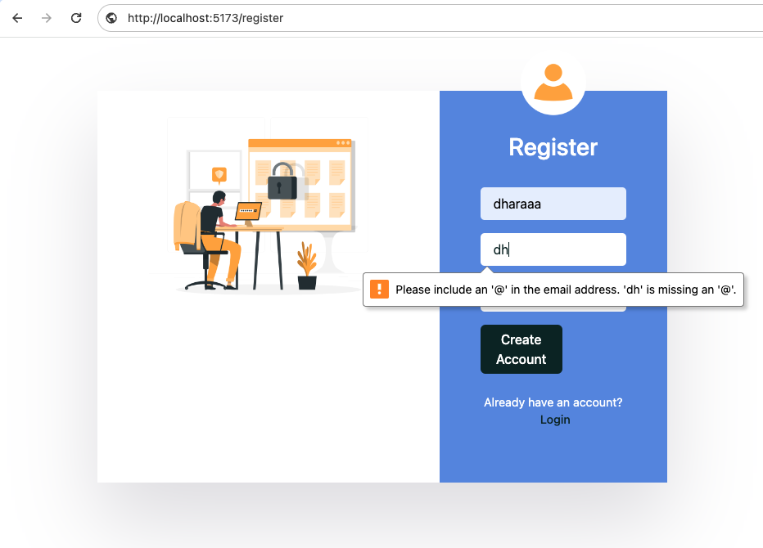
[Login – Register Page]

Slide 11
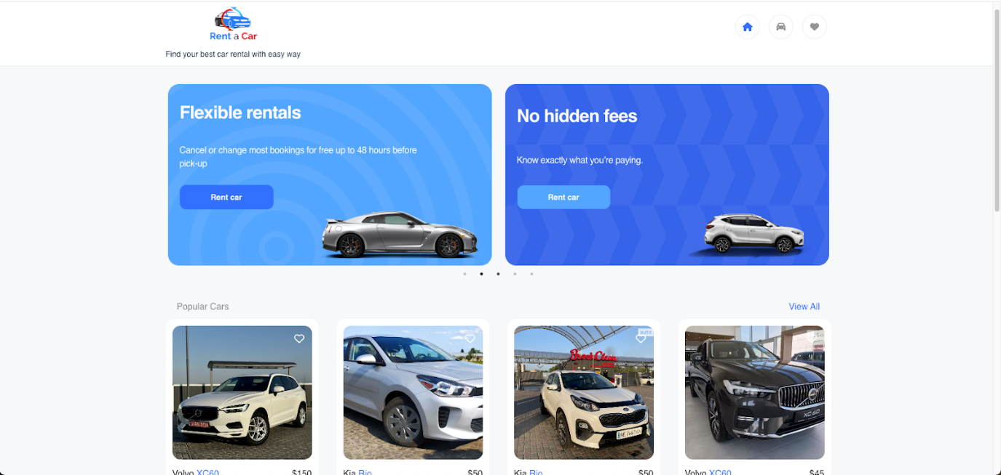
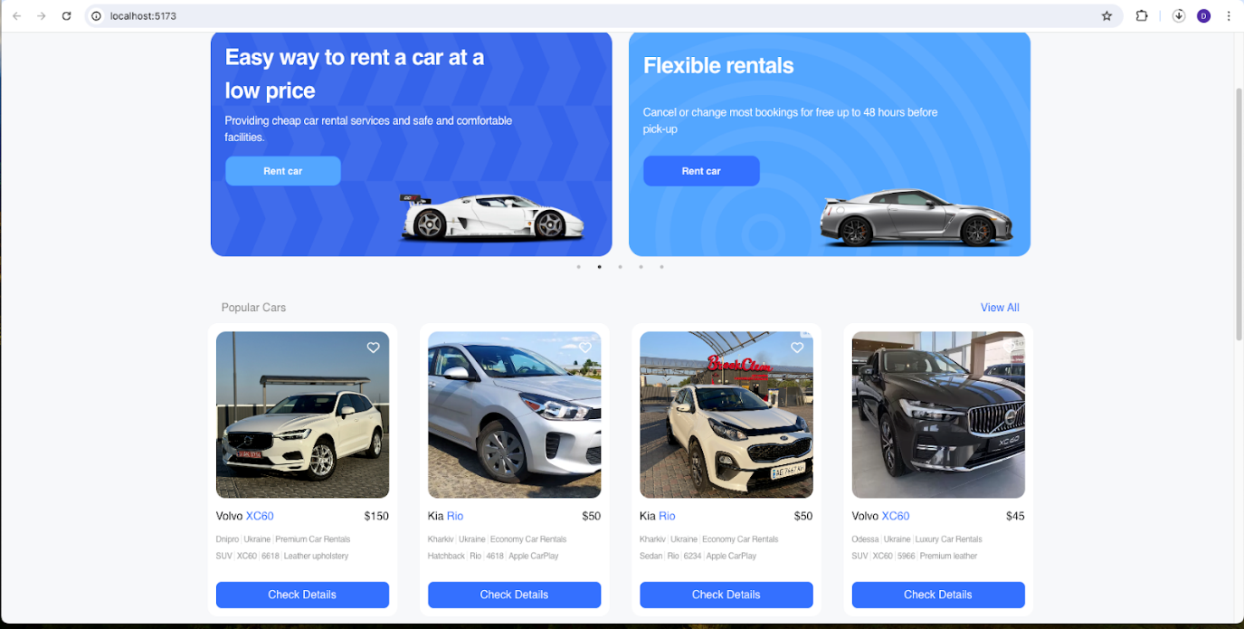
[Home Page]

Slide 12
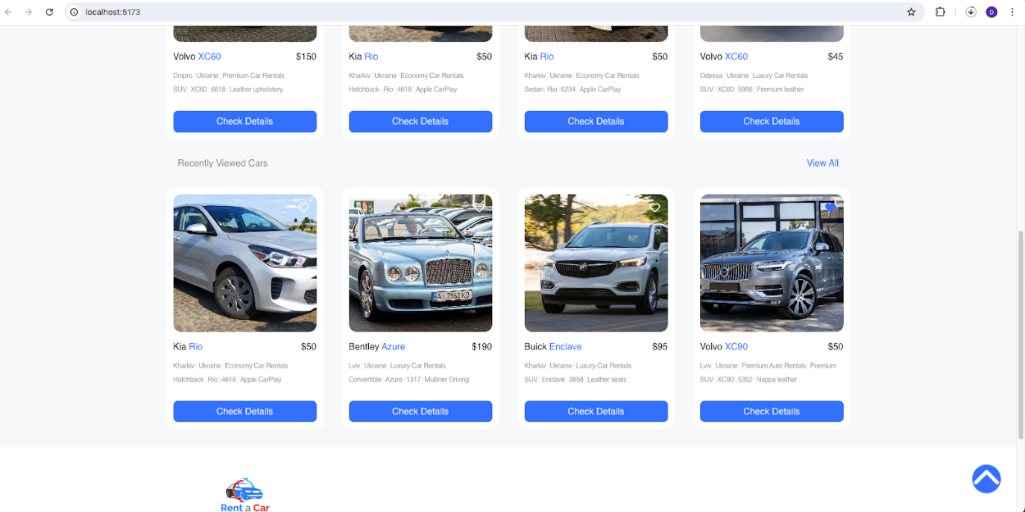
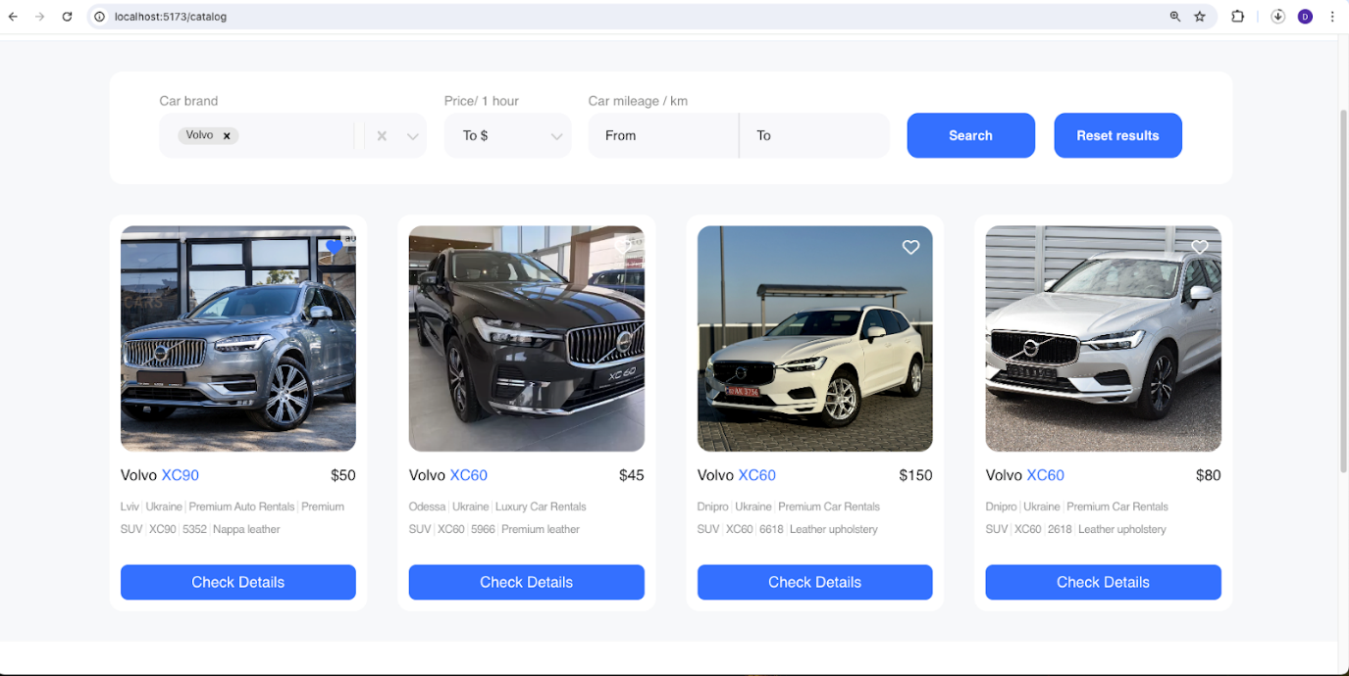
[Popular cars & Search-filter Page]

Slide 13
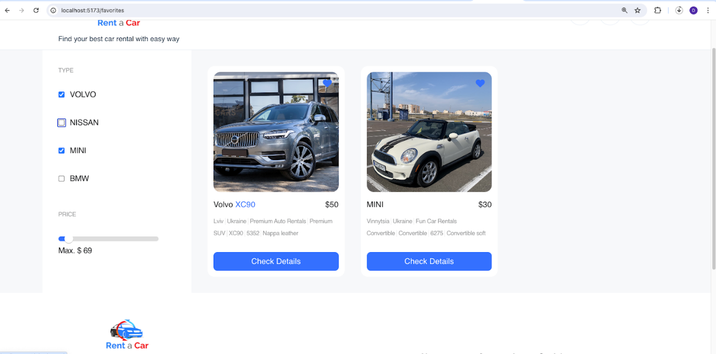
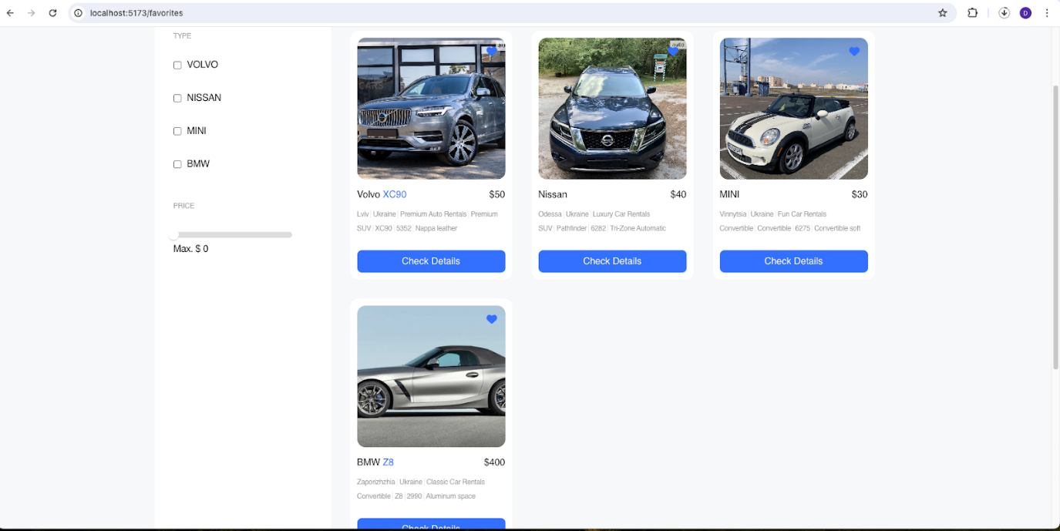
[Favourite car page with filters]

Slide 14
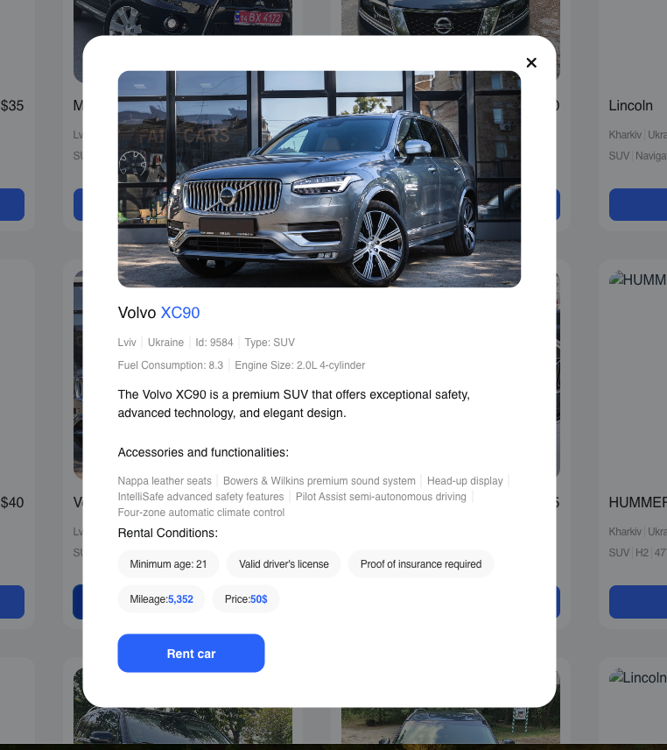
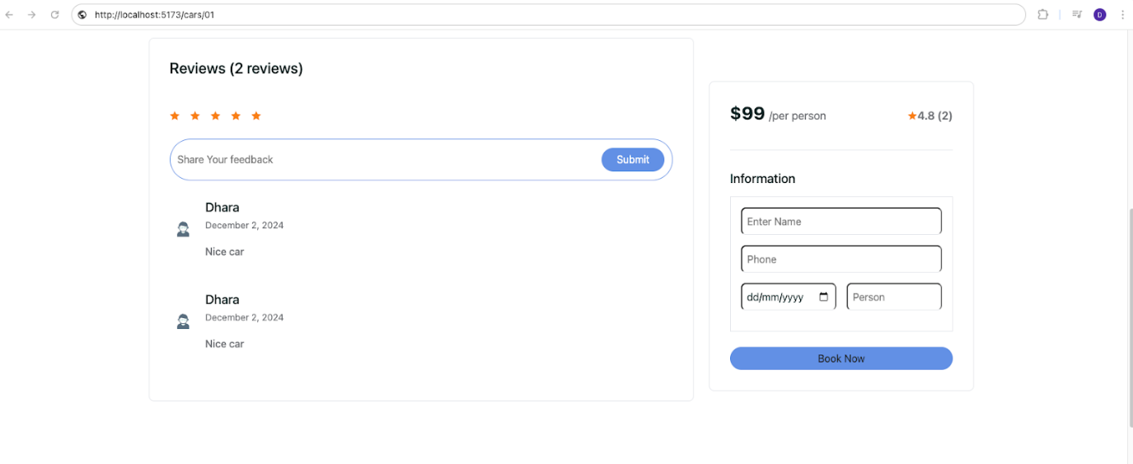
[Car-detail, book-now Page]

Slide 15
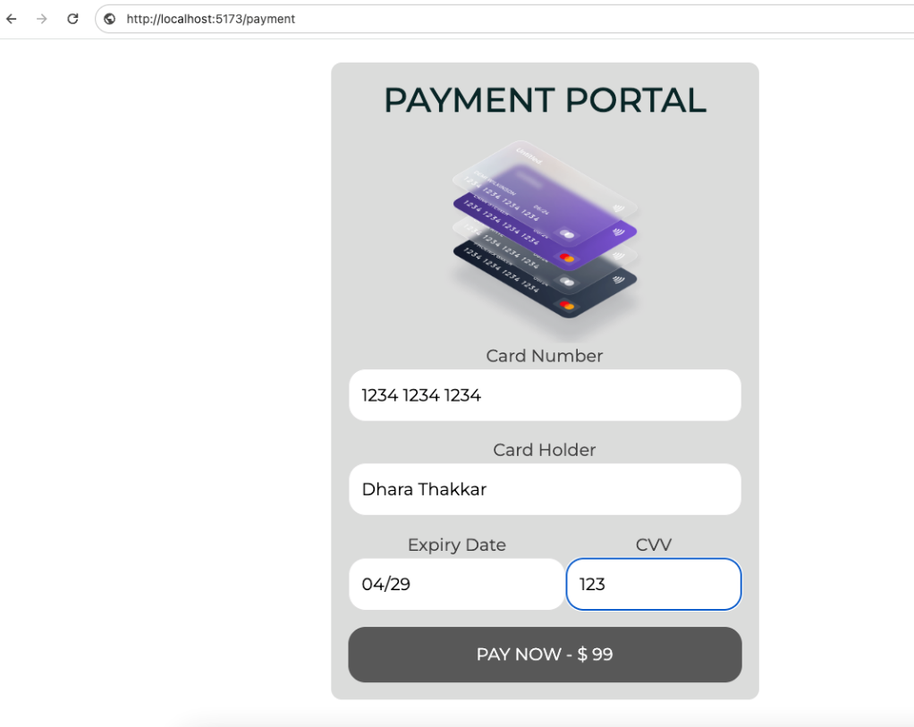
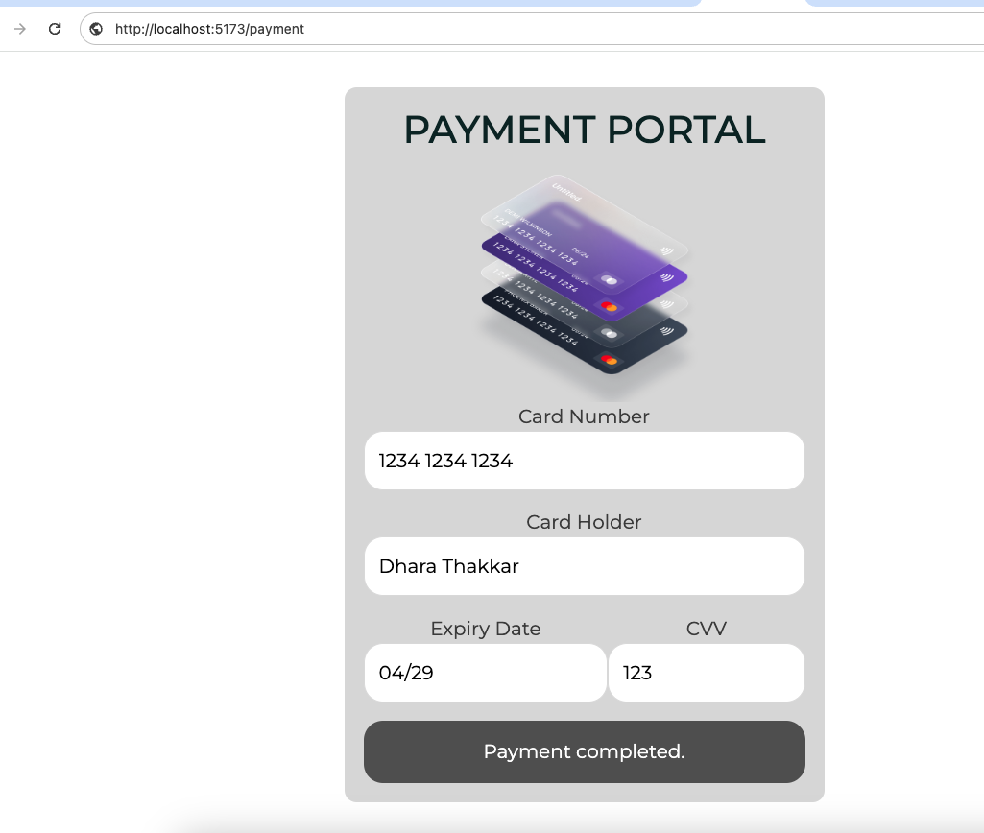
[Payment Page]

Slide 16
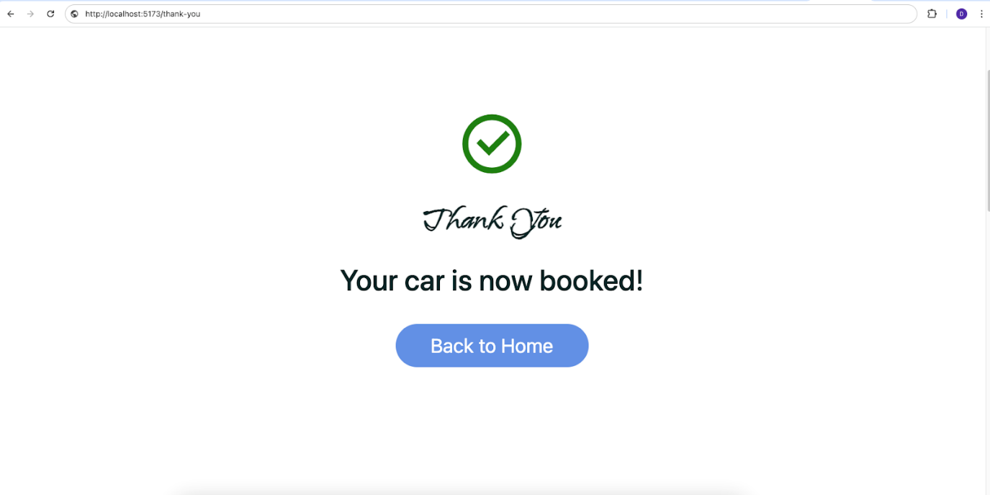
[Successful Booking Page]

Slide 17
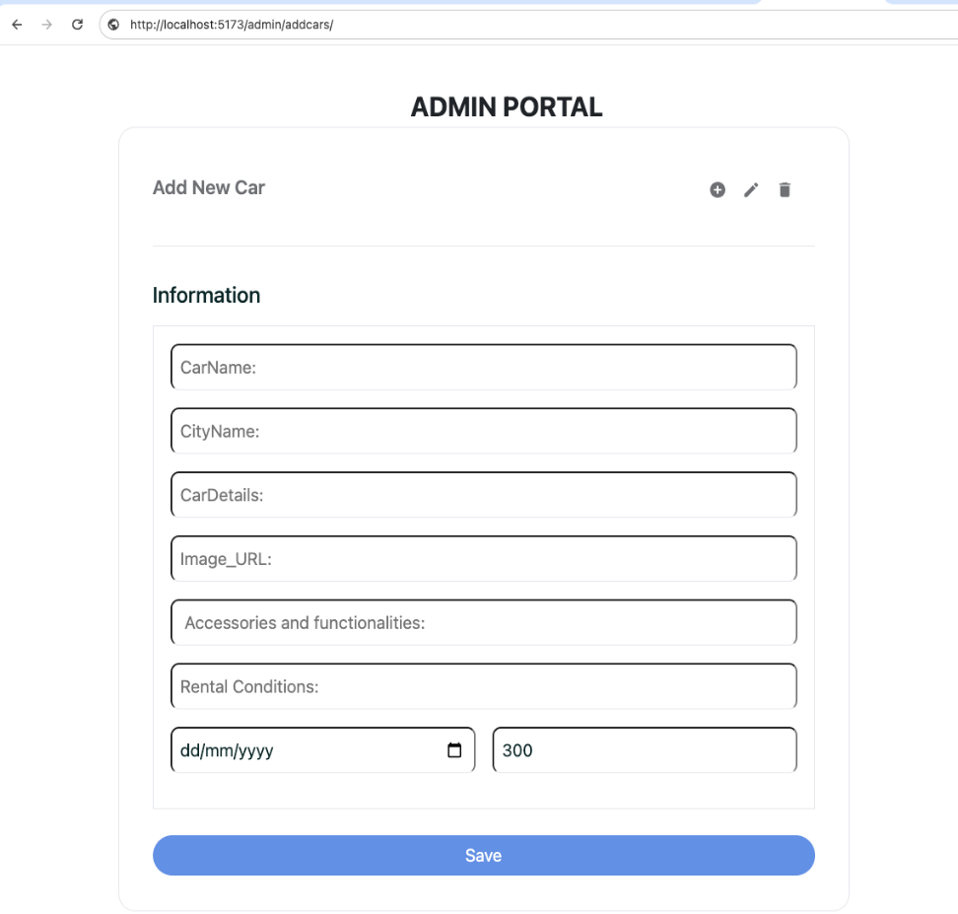
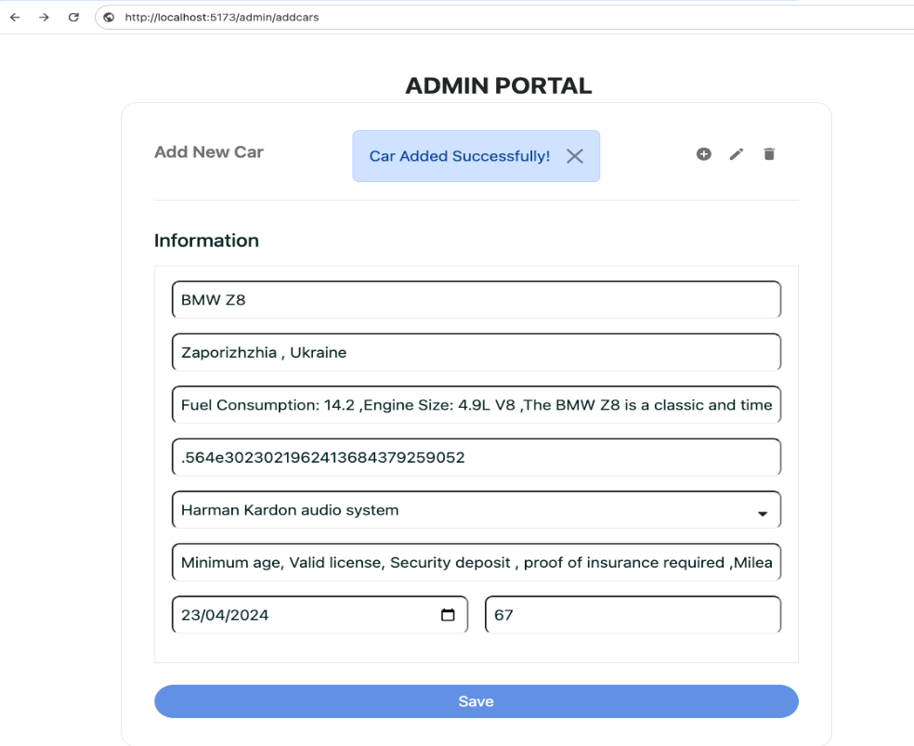
[Admin Portal for add car details]

Slide 18
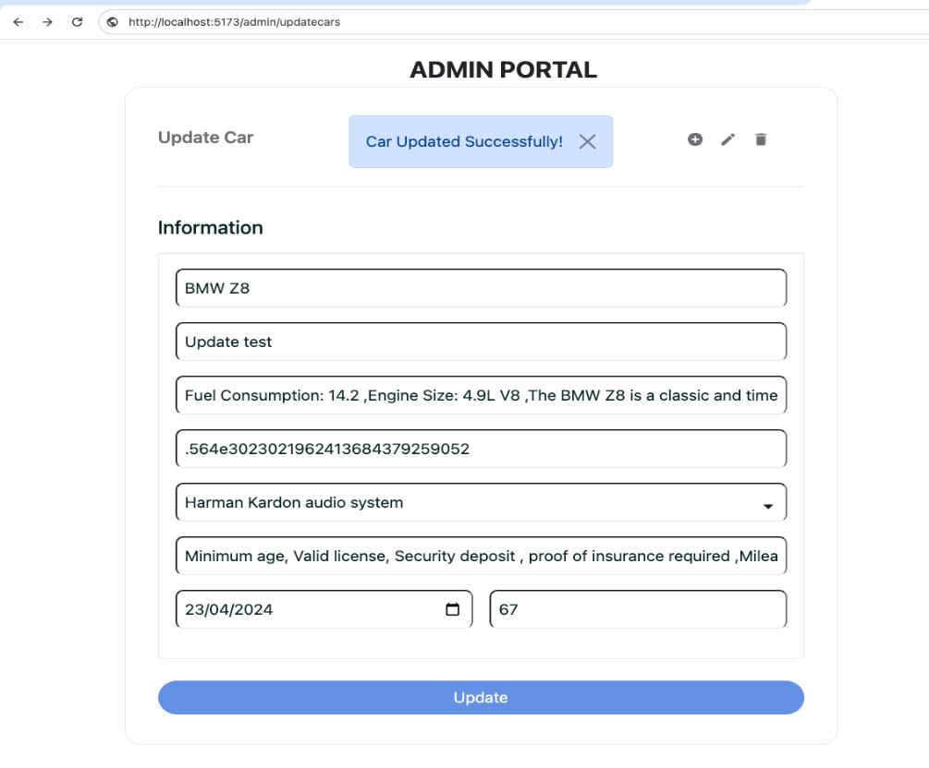
[Update car]

Slide 19
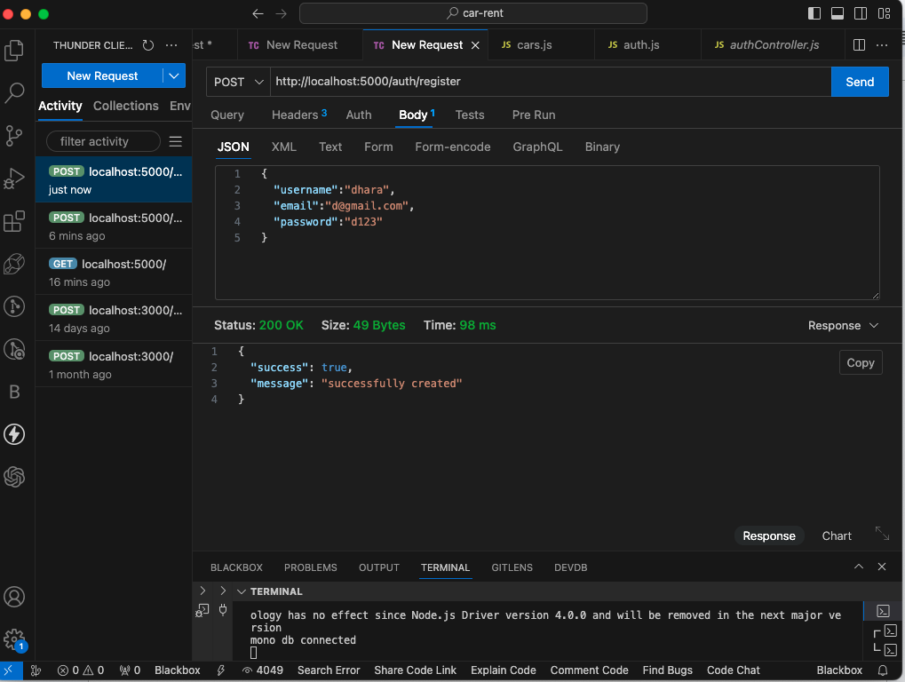
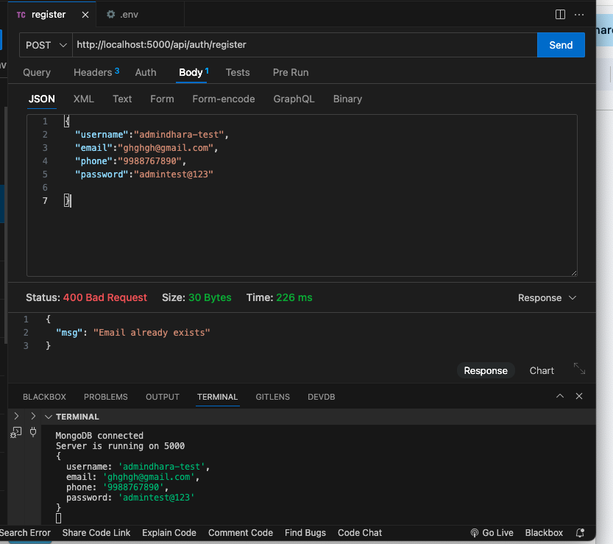
[Backend-api of registration with validation]

Slide 20
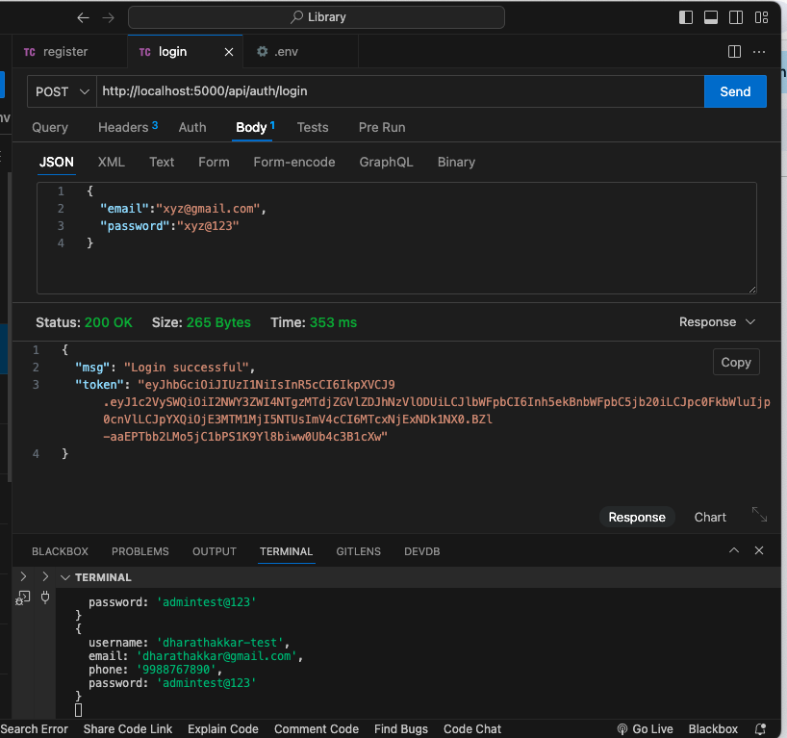
[Backend-api of Login with JWT token]

Slide 21
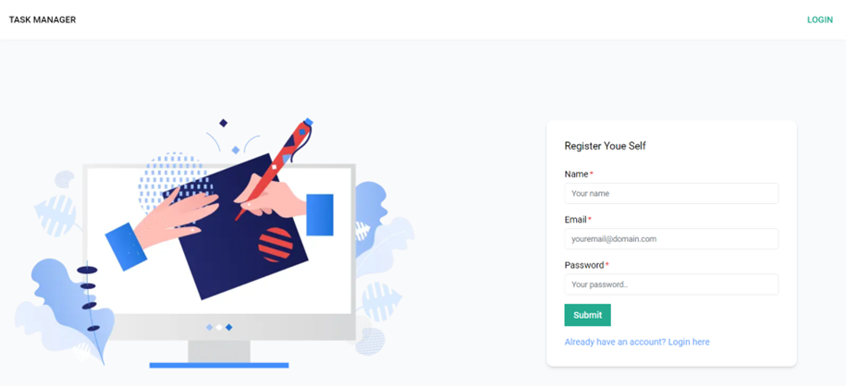
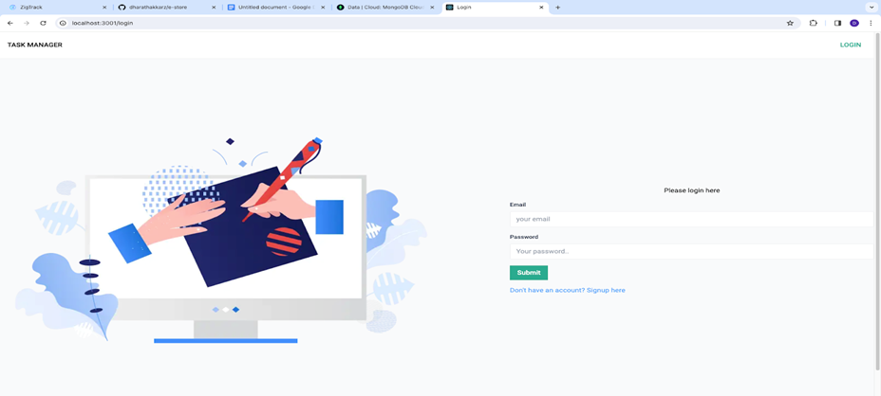
Screenshot of Other Task 1.Task Management App
[Signup, Login Page]

Slide 22
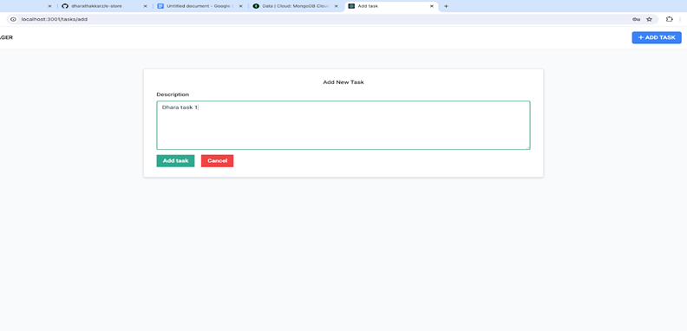
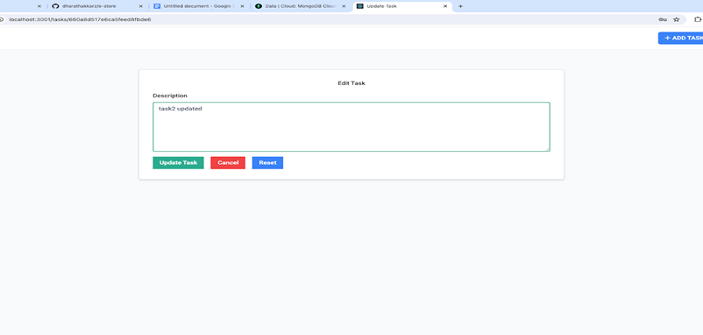
Screenshot of Other Task 1.Task Management App
[Add, Update Task Page]

Slide 23
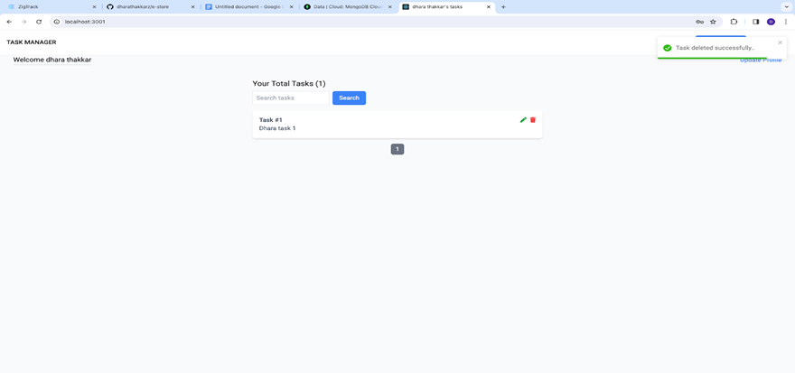
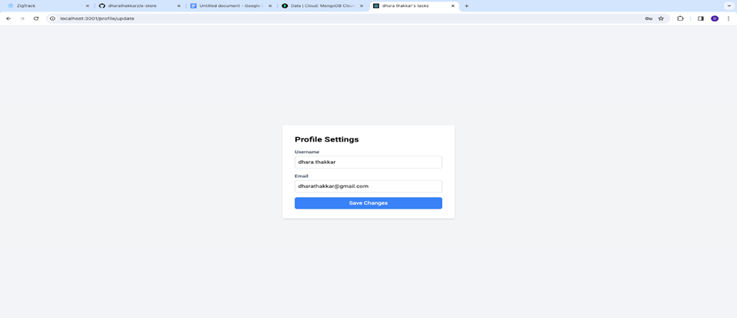
Screenshot of Other Task 1.Task Management App
[Search, Profile Update Page]

Slide 24
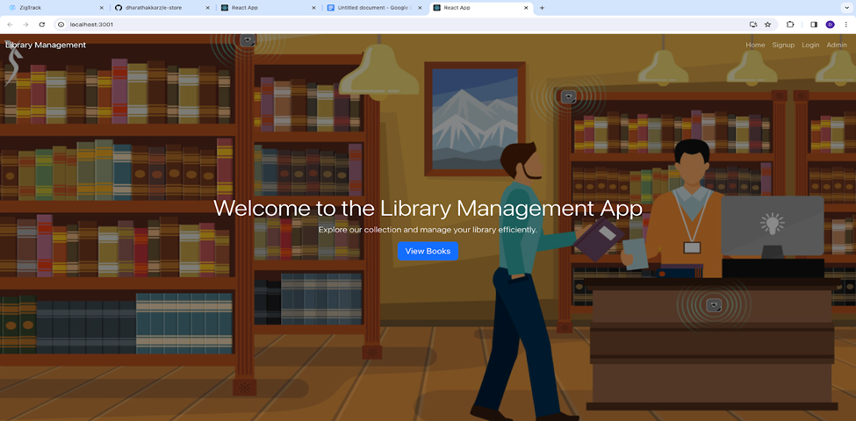
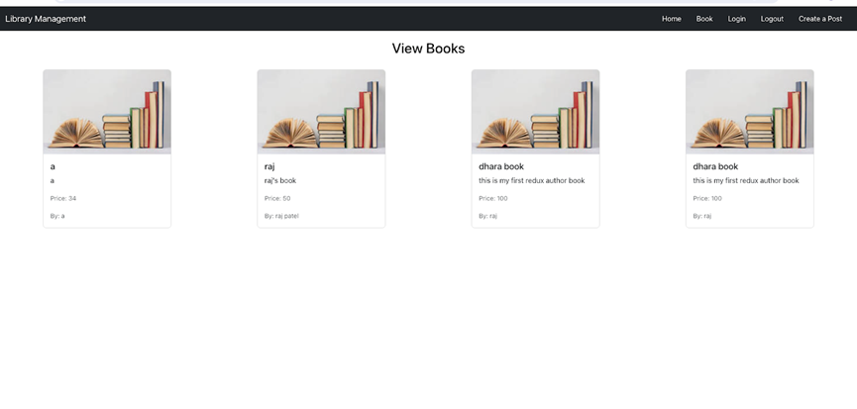
Screenshot of Other Task 2.Library Management System
[Home , View Book Page]

Slide 25
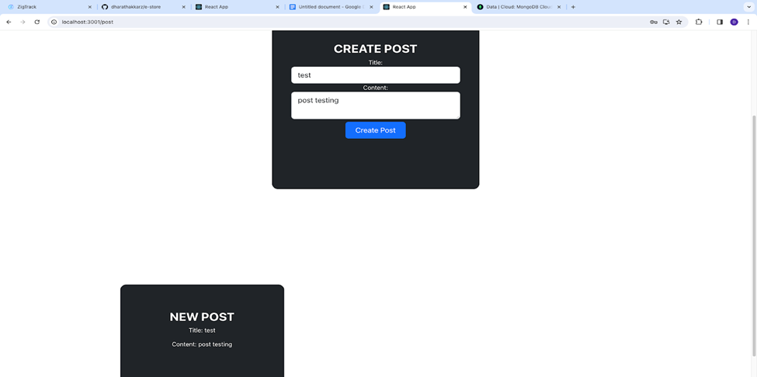
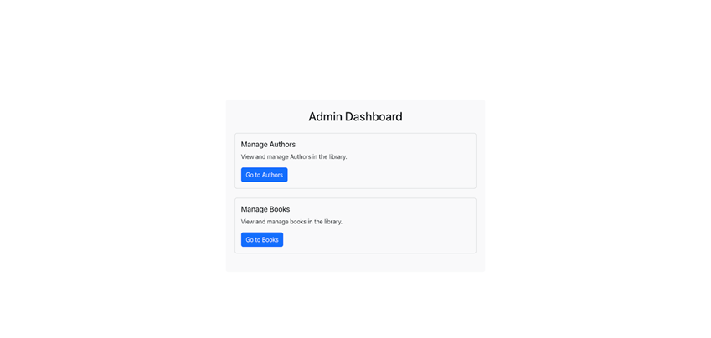
Screenshot of Other Task 2.Library Management System
[Admin,Personal-post Page]

Slide 26
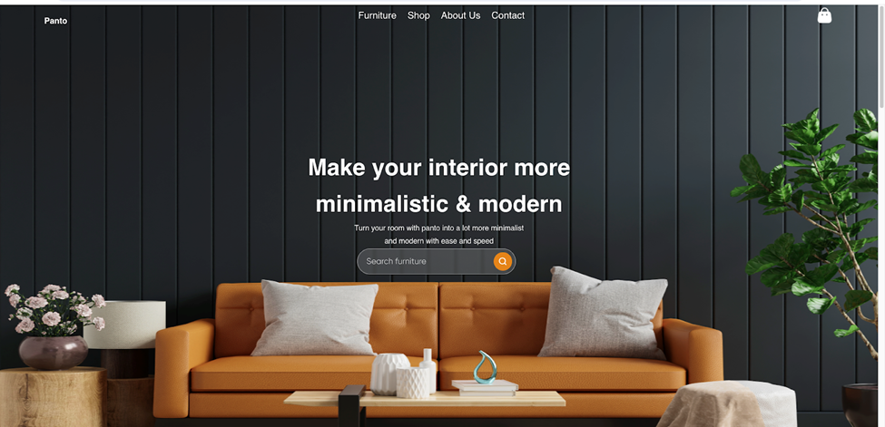
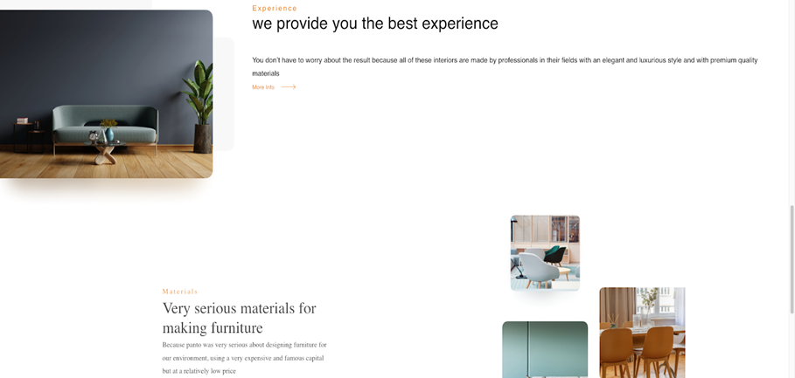
Screenshot of Other Task 3. Figma UI Design

Slide 27
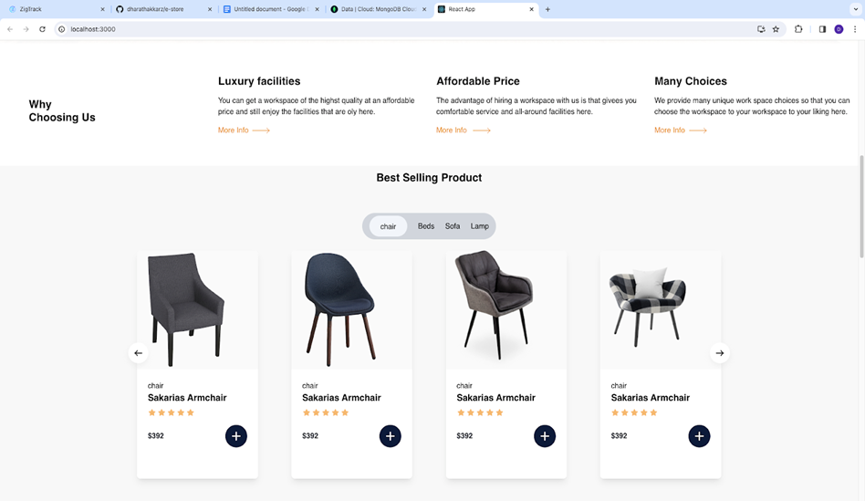
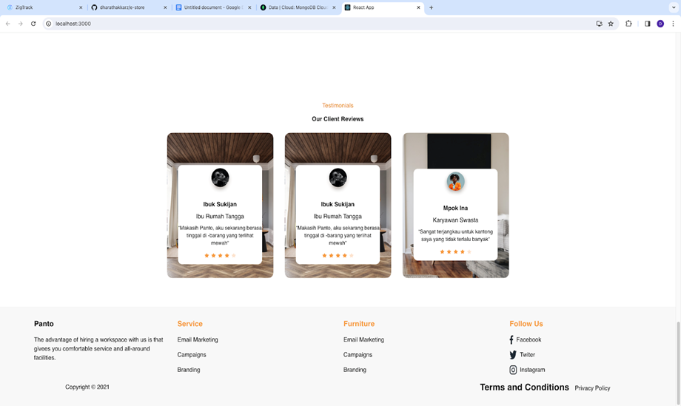
Screenshot of Other Task 3. Figma UI Design

Slide 28
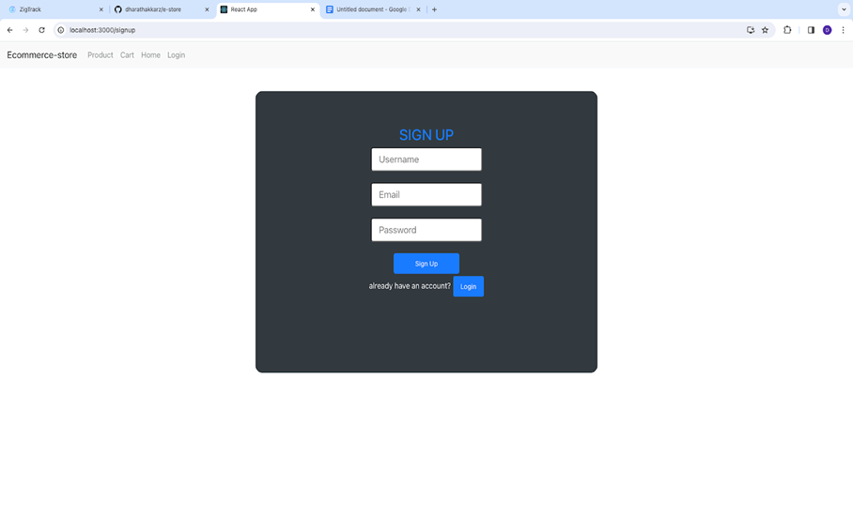
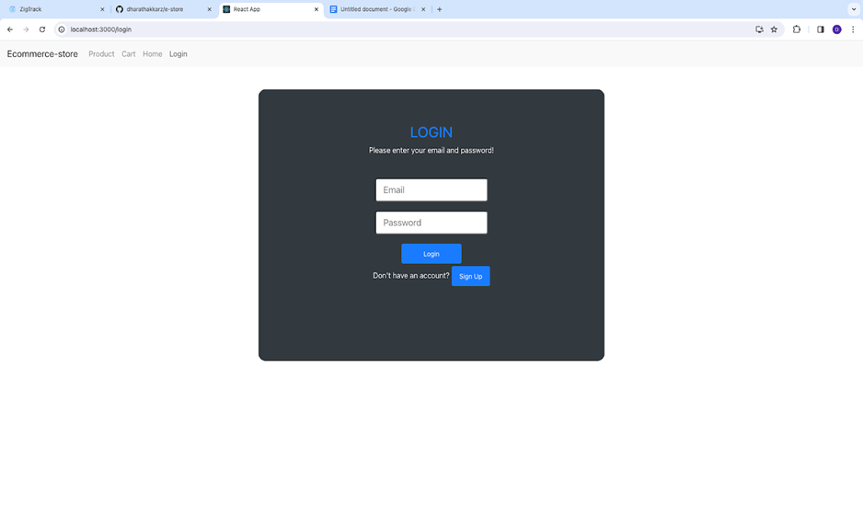
Screenshot of Other Task 4. E-commerce store

Slide 29
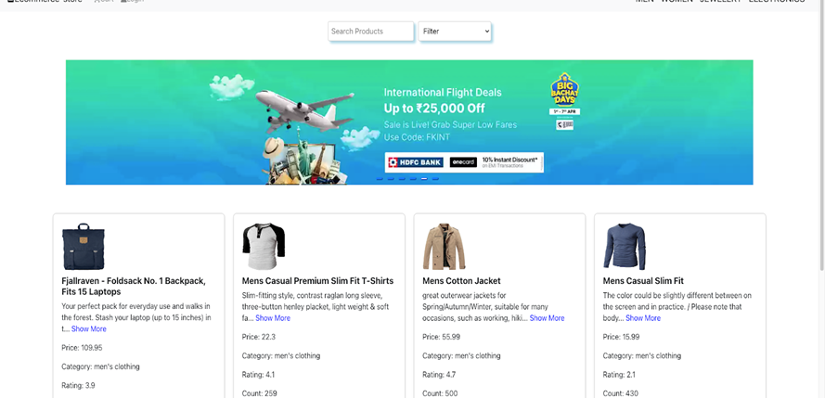
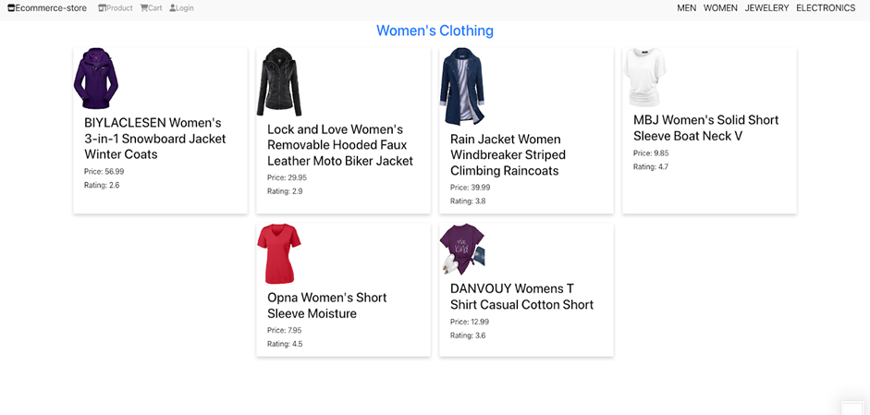
Screenshot of Other Task 4. E-commerce store

Slide 30
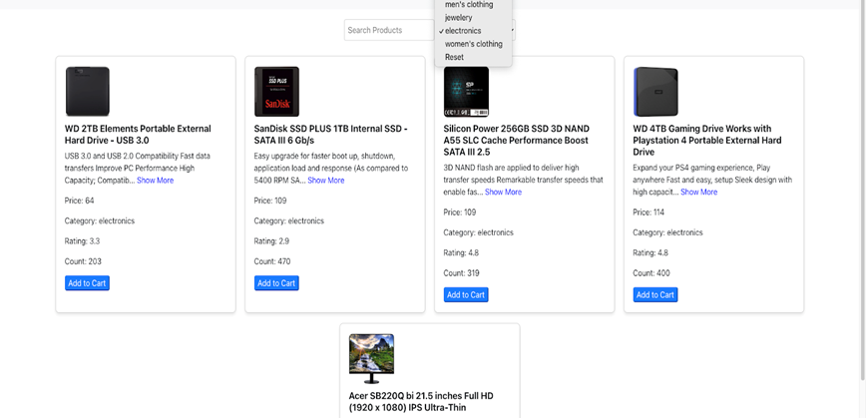
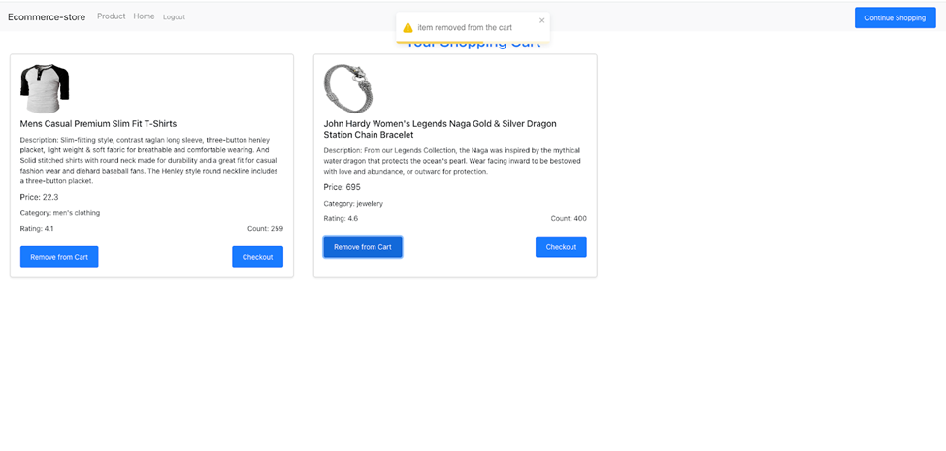
Screenshot of Other Task 4. E-commerce store

Slide 31



